Slide 1

Relational Algebra
Lecture 8
UECS 1203
DATABASE SYSTEM FUNDAMENTALS

Slide 2
Introduction
Relational algebra and relational calculus are formal languages associated with the relational model.
Informally, relational algebra is a (high-level) procedural language and relational calculus a non-procedural language.
However, formally both are equivalent to one another.

Slide 3
Relational Algebra
Relational algebra operations work on one or more relations to define another relation without changing the original relations.
Both operands and results are relations, so output from one operation can become input to another operation.
Allows expressions to be nested, just as in arithmetic. This property is called closure.

Slide 4
Relational Algebra
5 basic operations in relational algebra: Selection, Projection(unary operation)
Cartesian product, Union, and Set Difference. (binary operations)
These perform most of the data retrieval operations needed.
Also have Join, Intersection, and Division operations, which can be expressed in terms of 5 basic operations.

Slide 5
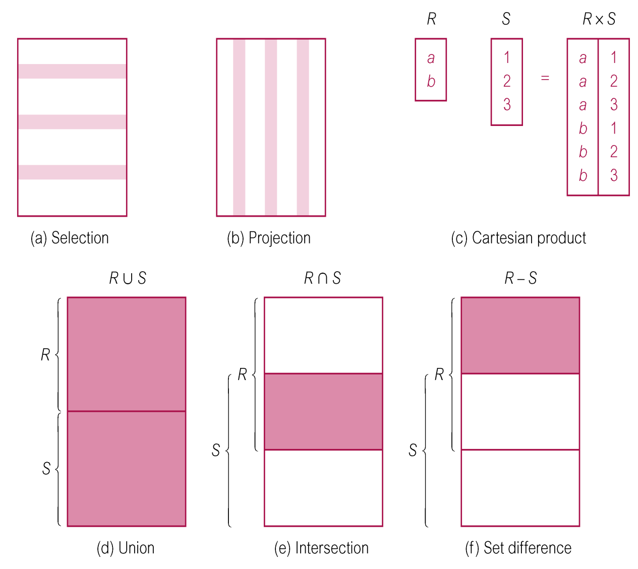
Relational Algebra Operations

Slide 6
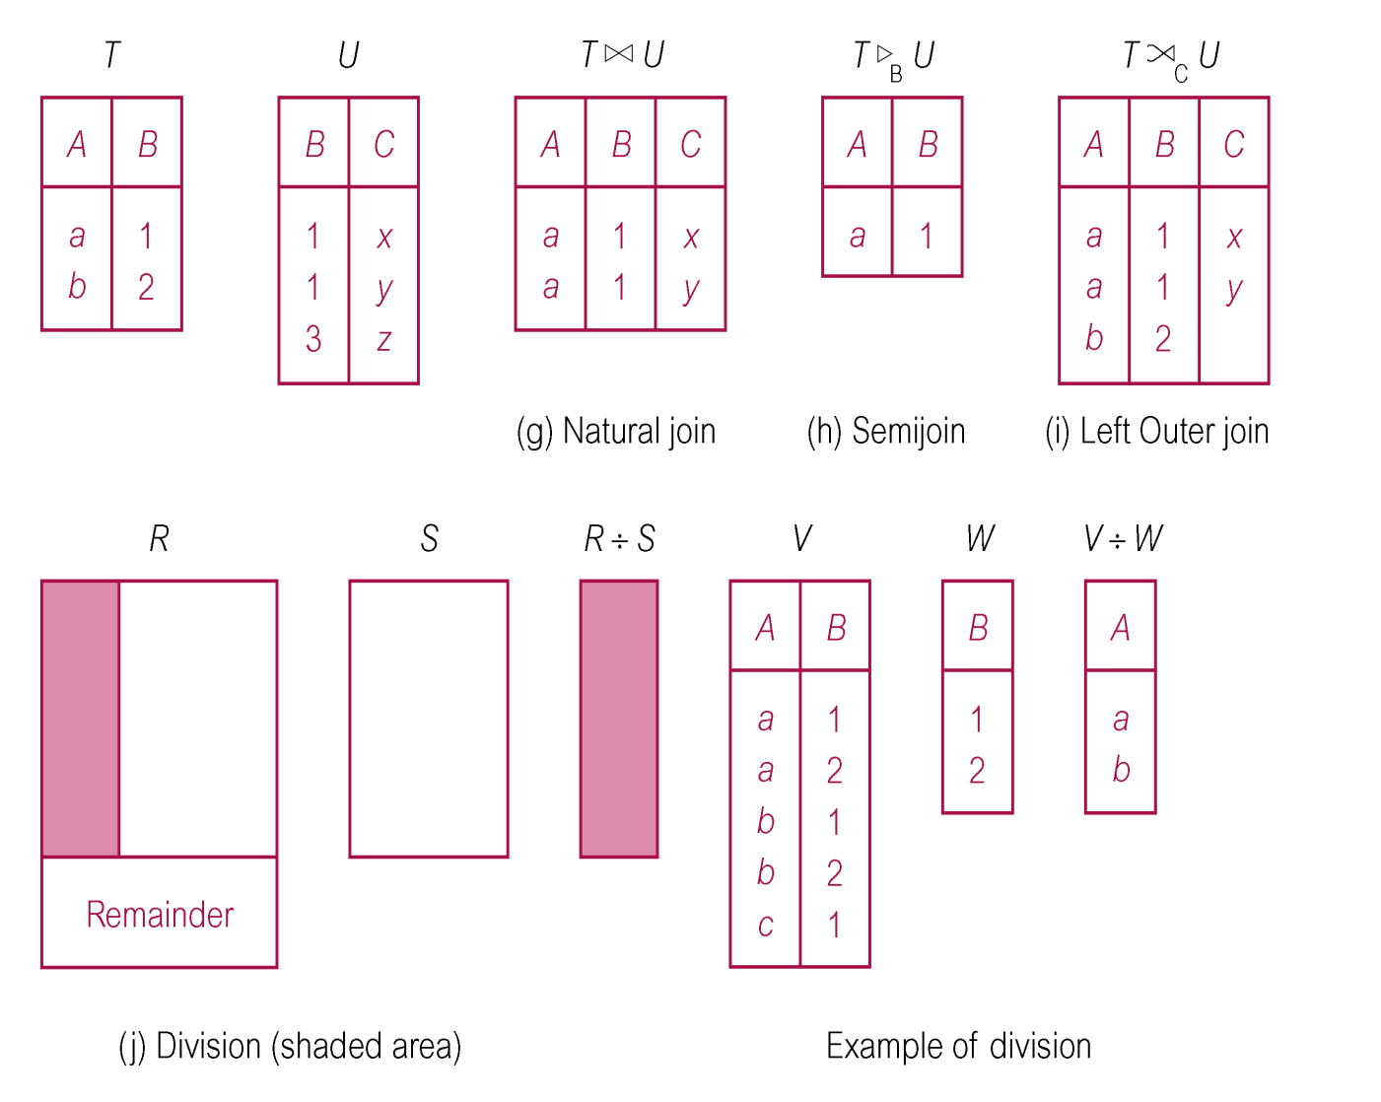
Relational Algebra Operations

Slide 7
Selection (or Restriction)
σ_{predicate} (R)
  Works on a single relation R and defines a relation that contains only those tuples (rows) of R that satisfy the specified condition (predicate).

Slide 8
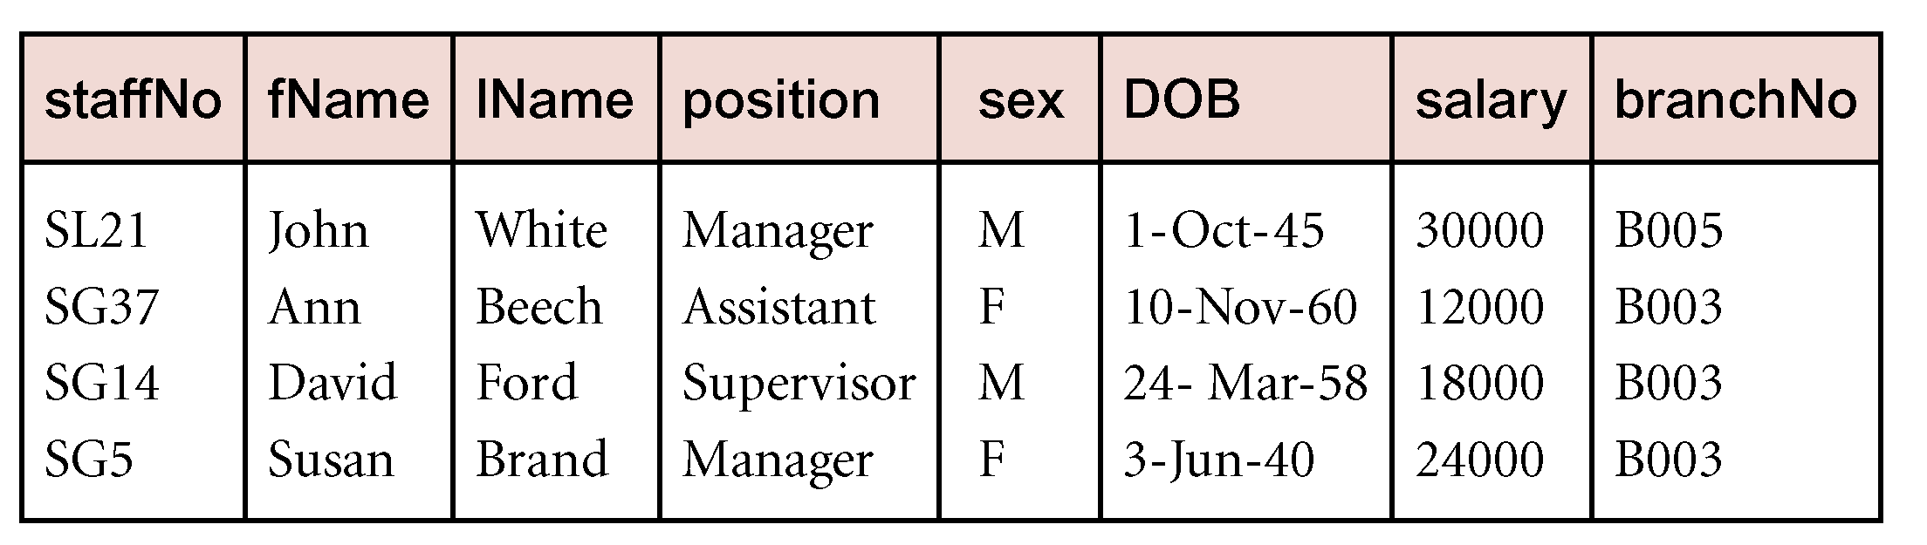
Example - Selection (or Restriction)
List all staff with a salary greater than £10,000.
  σ_{salary > 10000} (Staff)

Slide 9
Projection
Π_{col1, . . . , coln}(R)
  Works on a single relation R and defines a relation that contains a vertical subset of R, extracting the values of specified attributes and eliminating duplicates.

Slide 10
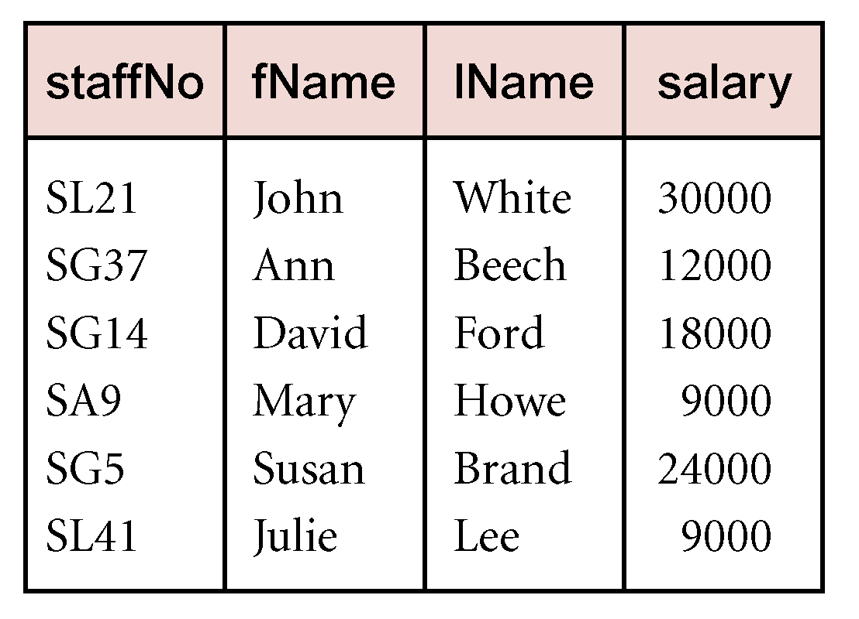
Example - Projection
Produce a list of salaries for all staff, showing only staffNo, fName, lName, and salary details.
  Π_{staffNo, fName, lName, salary}(Staff)

Slide 11
Union
R ∪ S
  Union of two relations R and S defines a relation that contains all the tuples of R, or S, or both R and S, duplicate tuples being eliminated.
  R and S must be union-compatible.
If R and S have I and J tuples, respectively, union is obtained by concatenating them into one relation with a maximum of (I + J) tuples.

Slide 12
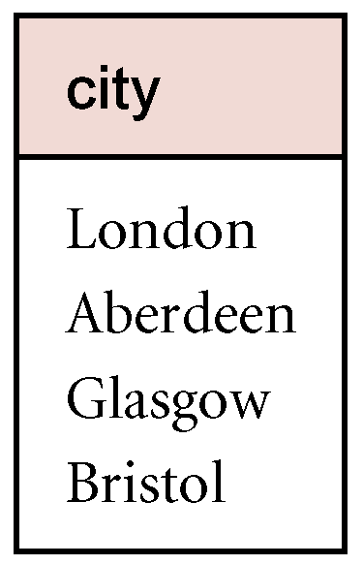
Example - Union
List all cities where there is either a branch office or a property for rent.
  Π_{city}(Branch) ∪ Π_{city}(PropertyForRent)

Slide 13
Set Difference
R – S
  Defines a relation consisting of the tuples that are in relation R, but not in S.
  R and S must be union-compatible.

Slide 14
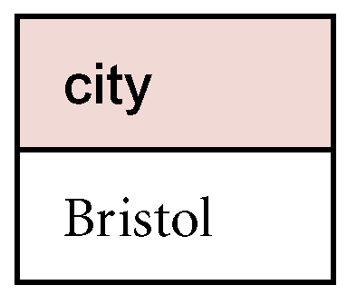
Example - Set Difference
List all cities where there is a branch office but no properties for rent.
  Π_{city}(Branch) – Π_{city}(PropertyForRent)

Slide 15
Intersection
R ∩ S
  Defines a relation consisting of the set of all tuples that are in both R and S.
  R and S must be union-compatible.
Expressed using basic operations:
  R ∩ S = R – (R – S)

Slide 16
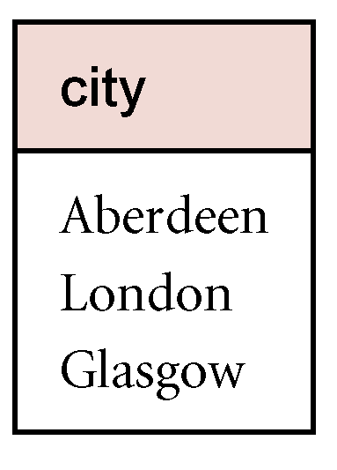
Example - Intersection
List all cities where there is both a branch office and at least one property for rent.
  Π_{city}(Branch) ∩ Π_{city}(PropertyForRent)

Slide 17
Cartesian product
R X S
  Defines a relation that is the concatenation of every tuple of relation R with every tuple of relation S.

Slide 18
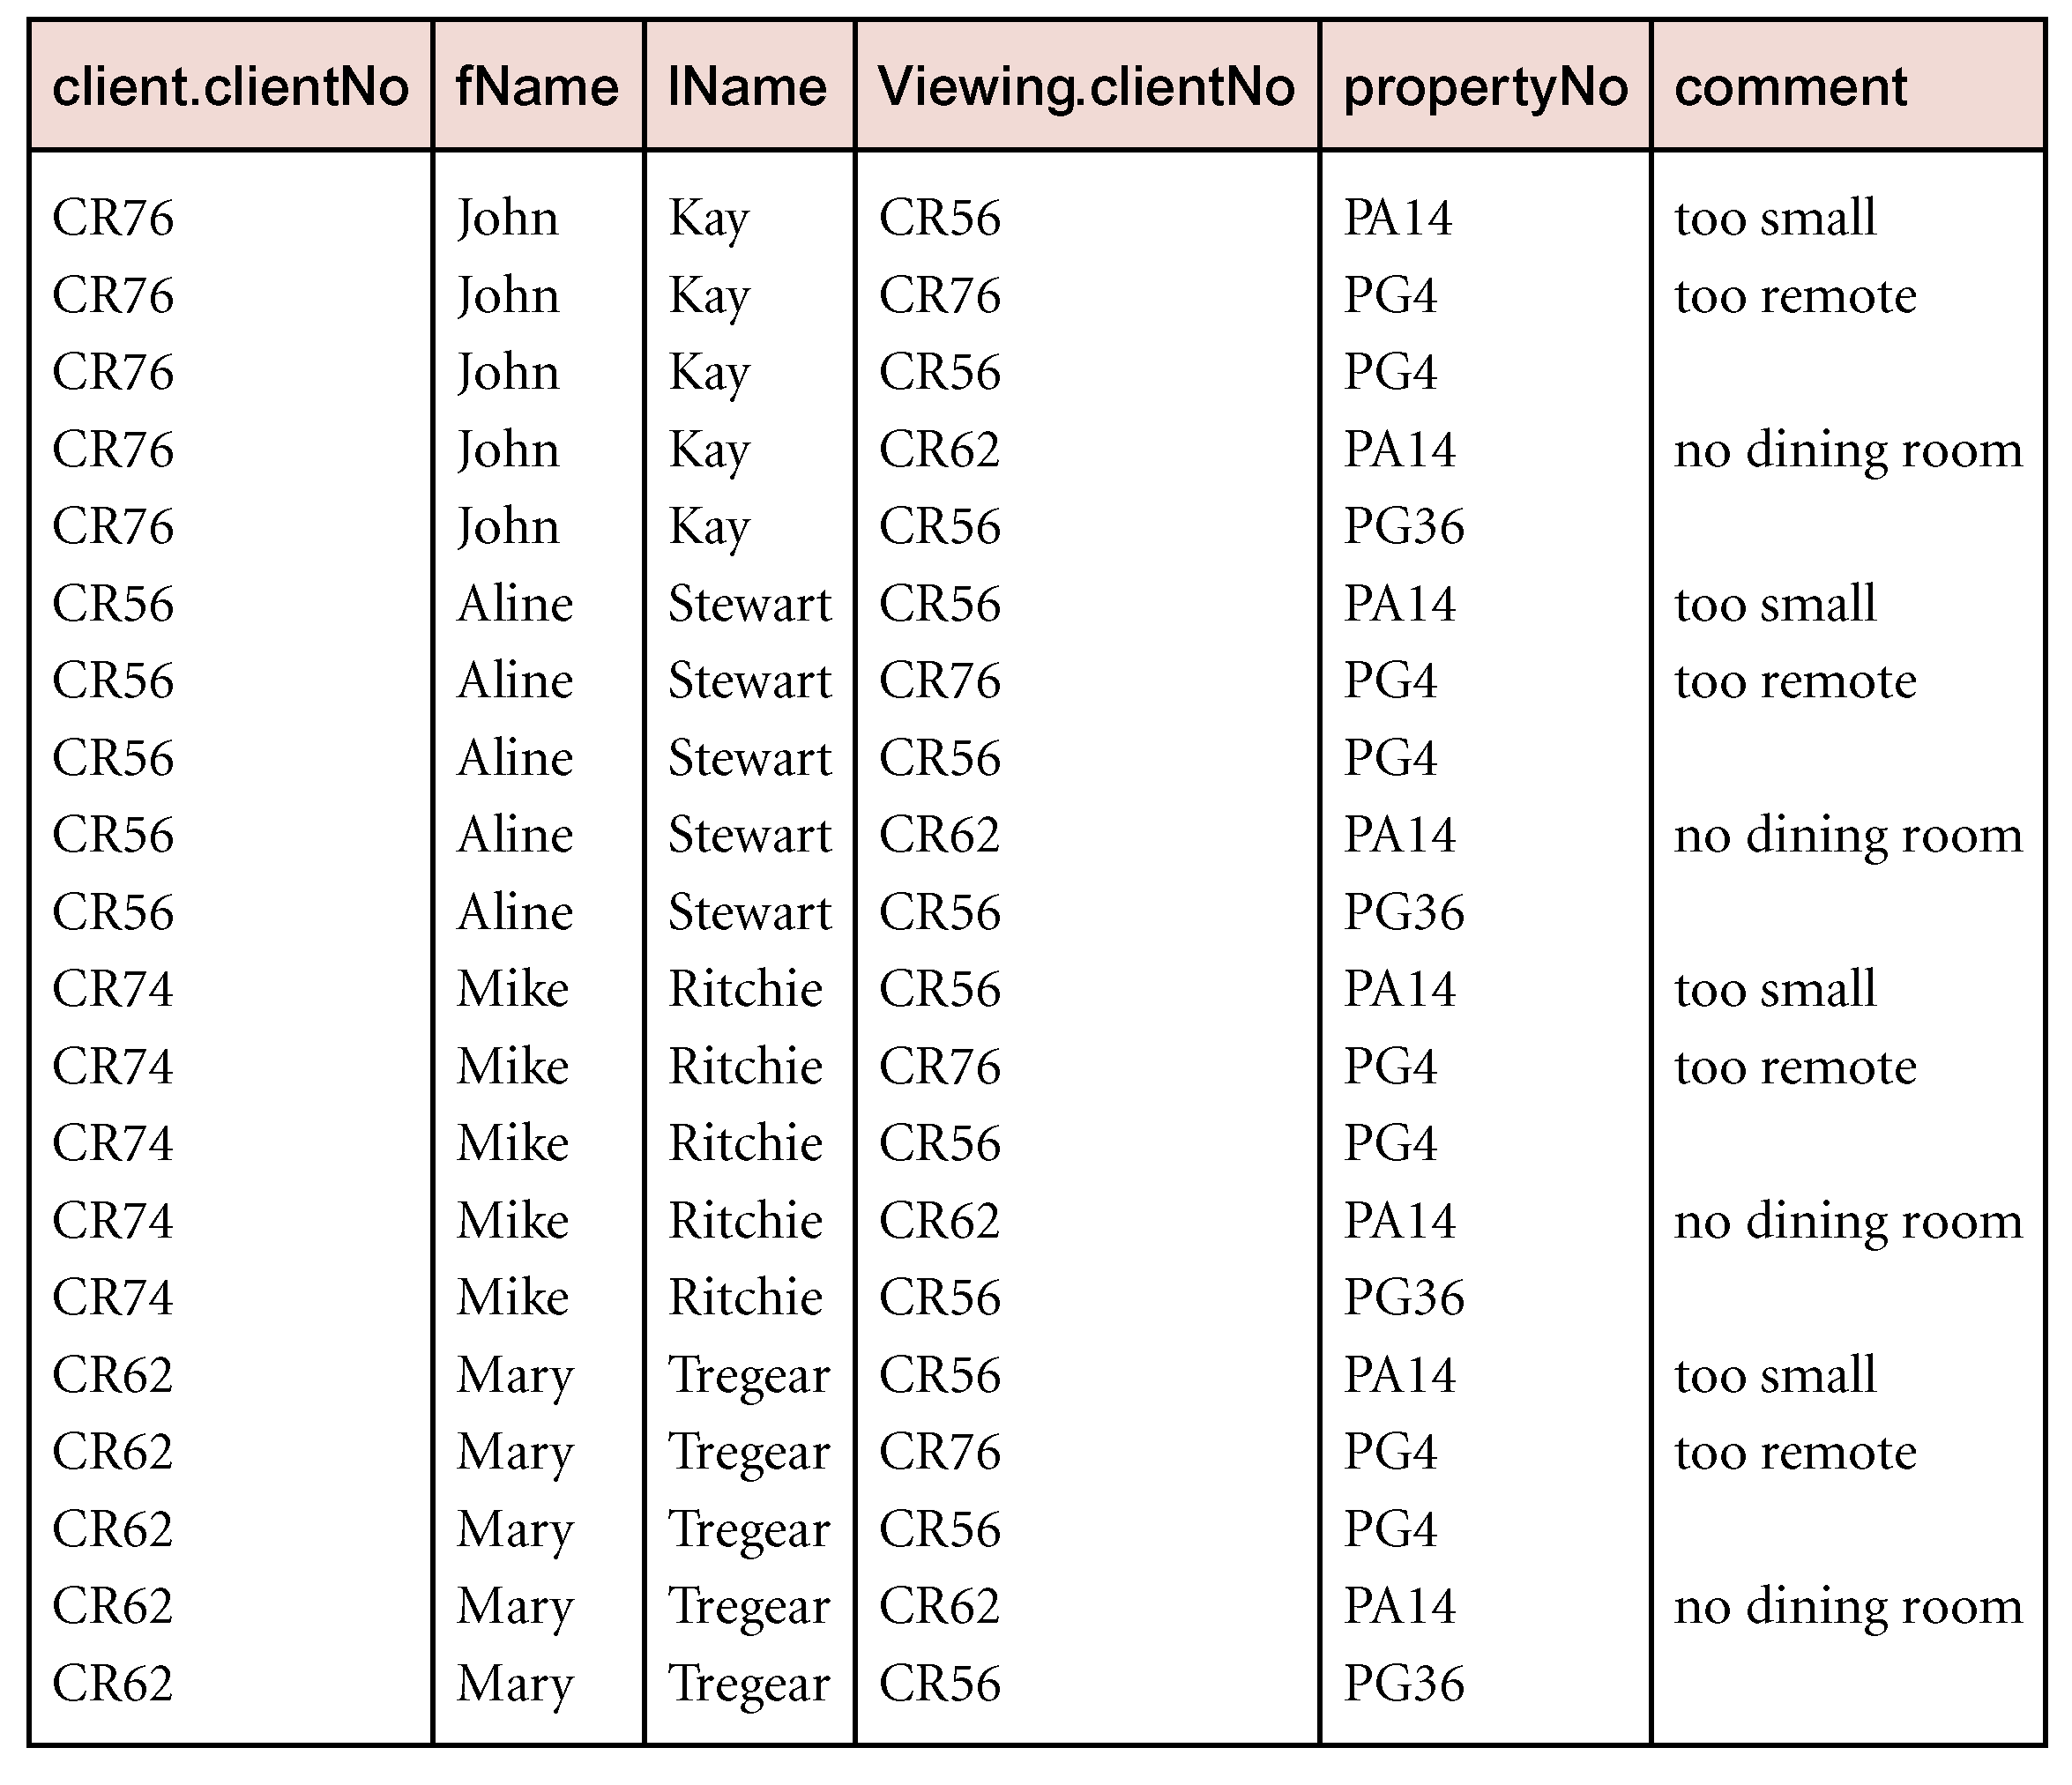
Example - Cartesian Product
List the names and comments of all clients who have viewed a property for rent.
  (Π_{clientNo, fName, lName}(Client)) X (Π_{clientNo, propertyNo,comment} (Viewing))

Slide 19
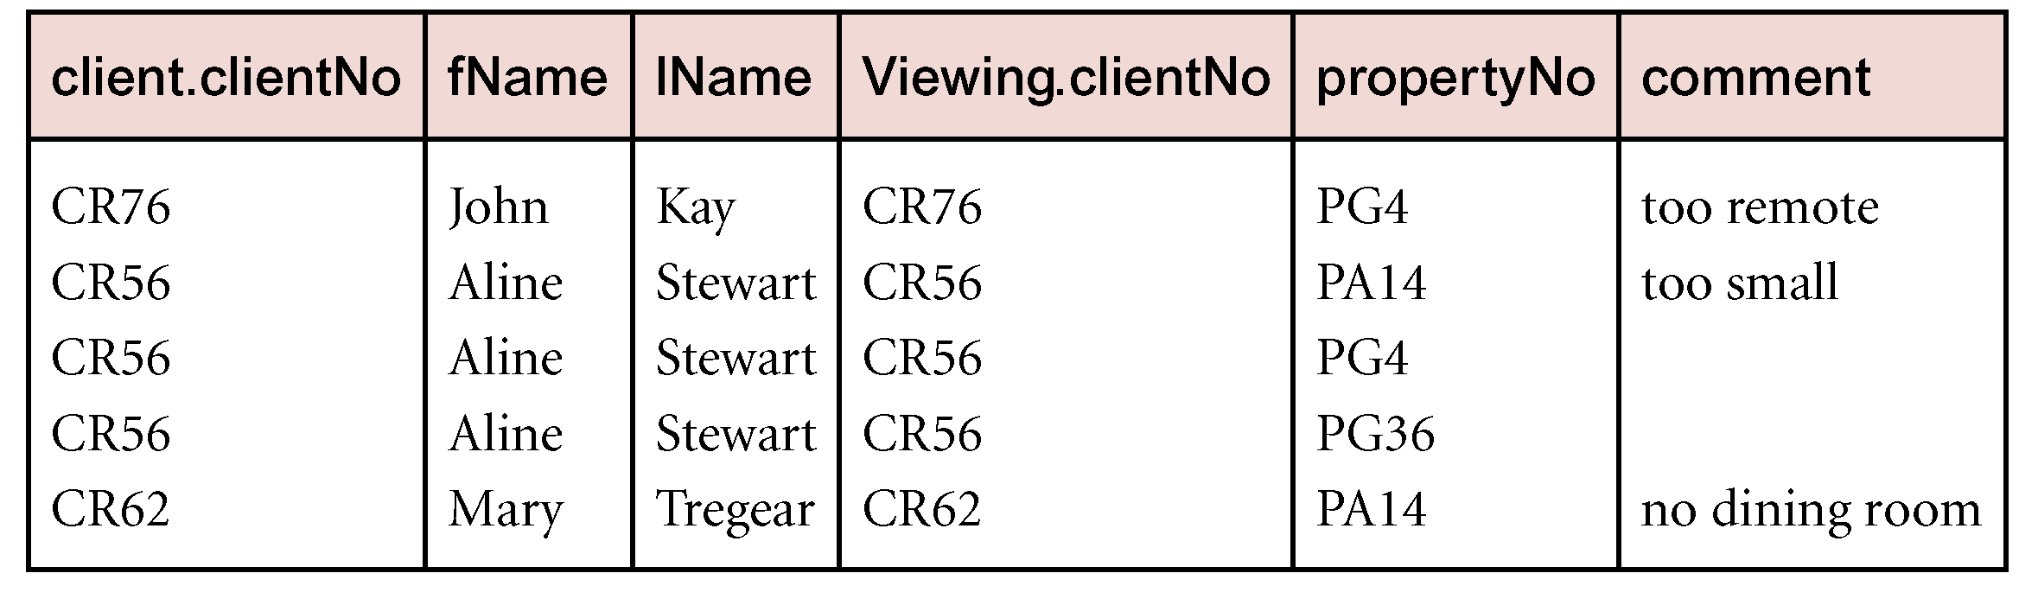
Example - Cartesian Product and Selection
Use selection operation to extract those tuples where Client.clientNo = Viewing.clientNo.
  σClient.clientNo = viewing.clientNo((∏_{clientNo,fName,lName}(Client)) Χ (∏_{clientNo,propertyNo,comment}(Viewing)))
Cartesian product and Selection can be reduced to a single operation called a Join.

Slide 20
Join Operations
Join is a derivative of Cartesian product.
Equivalent to performing a Selection, using join predicate as selection formula, over Cartesian product of the two operand relations.
One of the most difficult operations to implement efficiently in an RDBMS and one reason why RDBMSs have intrinsic performance problems.

Slide 21
Join Operations
Various forms of join operation
  Theta join
  Equijoin (a particular type of Theta join)
  Natural join
  Outer join
  Semijoin

Slide 22
Theta join (θ-join)
R _{F}S
  Defines a relation that contains tuples satisfying the predicate F from the Cartesian product of R and S.
  The predicate F is of the form R.a_{i} θ S.b_{i} where θ may be one of the comparison operators (<, ≤, >, ≥, =, ≠).

Slide 23
Theta join (θ-join)
Can rewrite Theta join using basic Selection and Cartesian product operations.
    R _{F}S = σ_{F}(R Χ S)
Degree of a Theta join is sum of degrees of the operand relations R and S. If predicate F contains only equality (=), the term Equijoin is used.

Slide 24
Example - Equijoin
List the names and comments of all clients who have viewed a property for rent.
  (Π_{clientNo,fName,lName}(Client)) Client.clientNo = Viewing.clientNo (Π_{clientNo,propertyNo,comment}(Viewing))

Slide 25
Natural Join
R S
  An Equijoin of the two relations R and S over all common attributes x. One occurrence of each common attribute is eliminated from the result.

Slide 26
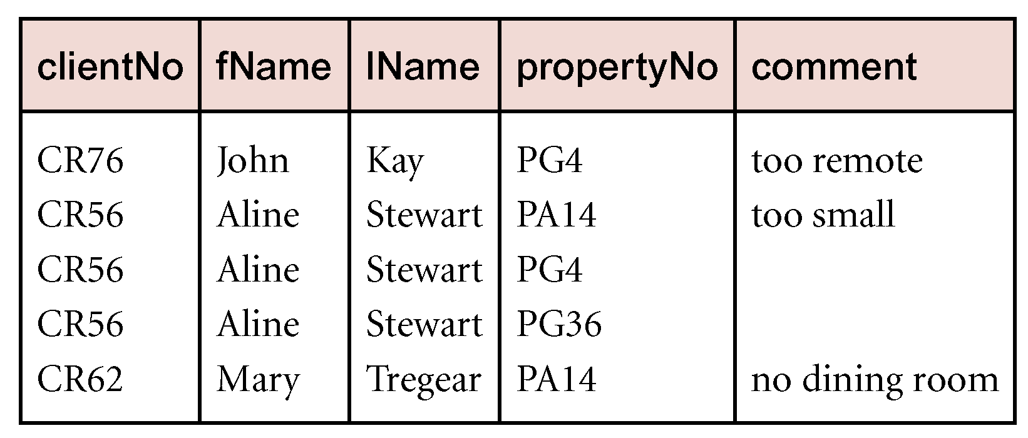
Example - Natural Join
List the names and comments of all clients who have viewed a property for rent.
  (Π_{clientNo,fName,lName}(Client)) (Π_{clientNo,propertyNo,comment}(Viewing))

Slide 27
Outer join
To display rows in the result that do not have matching values in the join column, use Outer join.
R S
  (Left) outer join is join in which tuples from R that do not have matching values in common columns of S are also included in result relation.

Slide 28
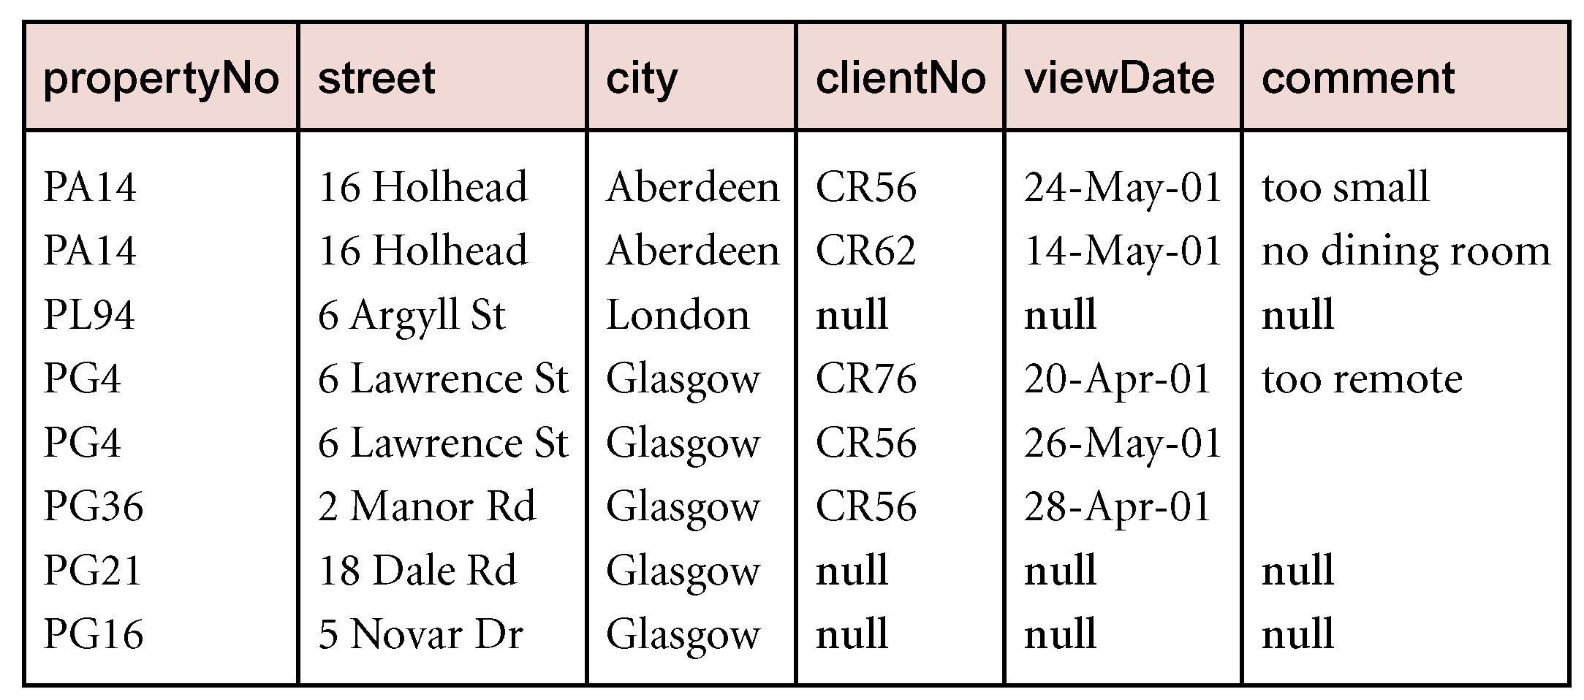
Example - Left Outer join
Produce a status report on property viewings.
  Π_{propertyNo,street,city}(PropertyForRent) Viewing

Slide 29
Semijoin
R _{F}S
  Defines a relation that contains the tuples of R that participate in the join of R with S.
Can rewrite Semijoin using Projection and Join:
  R _{F}S = Π_{A}(R _{F} S)

Slide 30
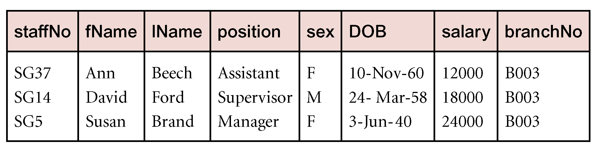
Example - Semijoin
List complete details of all staff who work at the branch in Glasgow.
  Staff Staff.brancNo = Branch.branchNo and branch.city = ‘Glasgow’ Branch

Slide 31
Division
R ÷ S
  Defines a relation over the attributes C that consists of set of tuples from R that match combination of every tuple in S.
Expressed using basic operations:
  T₁ ← Π_{C}(R)
  T₂ ← Π_{C}((S X T₁) – R)
  T ← T₁ – T₂

Slide 32
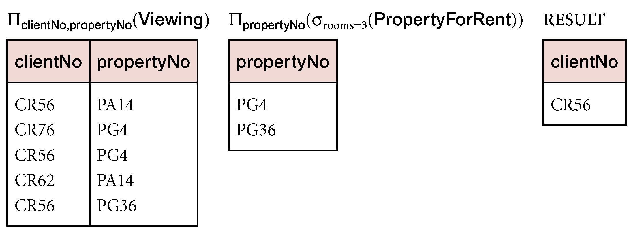
Example - Division
Identify all clients who have viewed all properties with three rooms.
  (Π_{clientNo,propertyNo}(Viewing)) ÷ (Π_{propertyNo}(σ_{rooms = 3} (PropertyForRent)))

Slide 33
Relational Algebra
Provides a formal foundation for relational model operations.
Basis for implementing and optimizing queries in RDBMS
Some of its concepts incorporated into SQL standard query language for RDBMS

